Slide 1

1 SAMUEL

Slide 2

1 SAMUEL
Polish Remover

Slide 3
1 SAMUEL
1 and 2 Samuel are one book in Hebrew canon
1st of 4 Kings in LXX and Vulgate
1 Samuel = 1 Kings
2 Samuel = 2 Kings
1 Kings = 3 Kings
2 Kings = 4 Kings

Slide 4
1 SAMUEL
From the birth of Samuel to the death of Saul

Slide 5
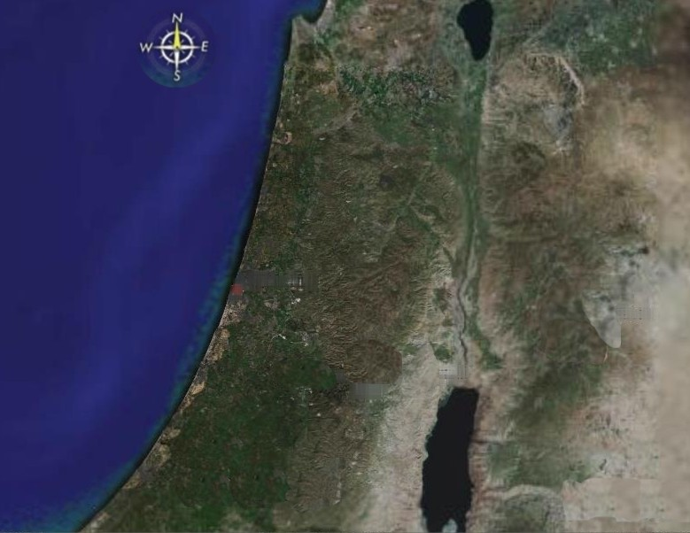
1 SAMUEL
Ebenezer
Shiloh
Aphek
Ashdod
Travels of the Ark in 1 Samuel

Slide 6
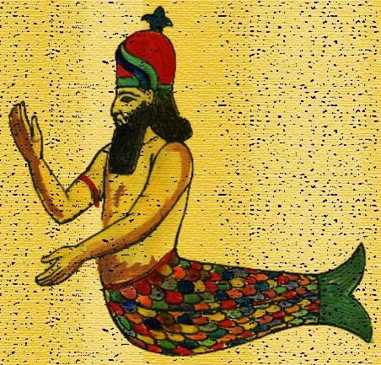
1 SAMUEL

Slide 7
1 SAMUEL
Tumors ~ KJV, emerods

Slide 8
1 SAMUEL
Ebenezer
Shiloh
Aphek
Kirjath Jearim
Ekron
Ashdod
Beth Shemesh
Gath
Travels of the Ark in 1 Samuel

